Slide 1
A simple word dictionary
#01
Online dictionary

Slide 2
Need of Project
Internet
JDK 8
Eclipsc IDE
Dictonary API
Core Java
Java GUI
JSON

Slide 3
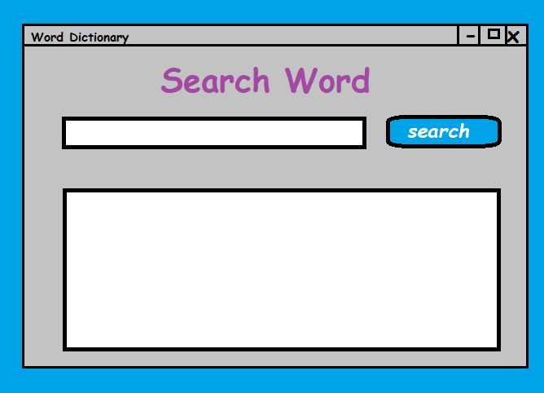
Gui design

Slide 4
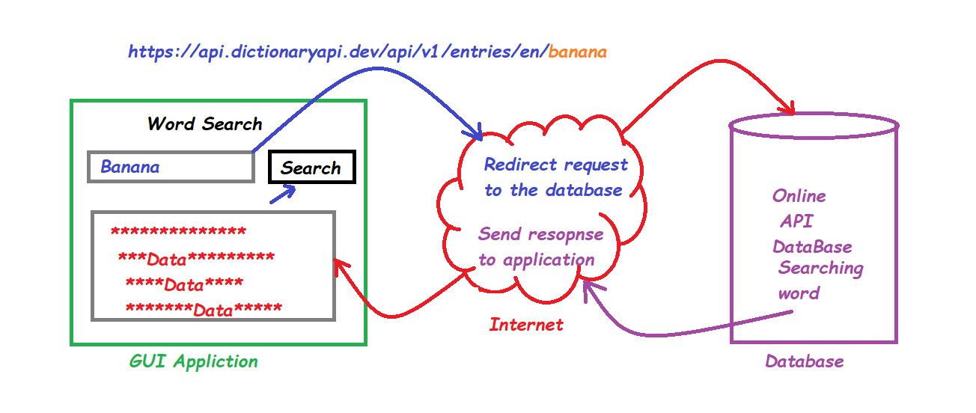
Flow of execution

Slide 5
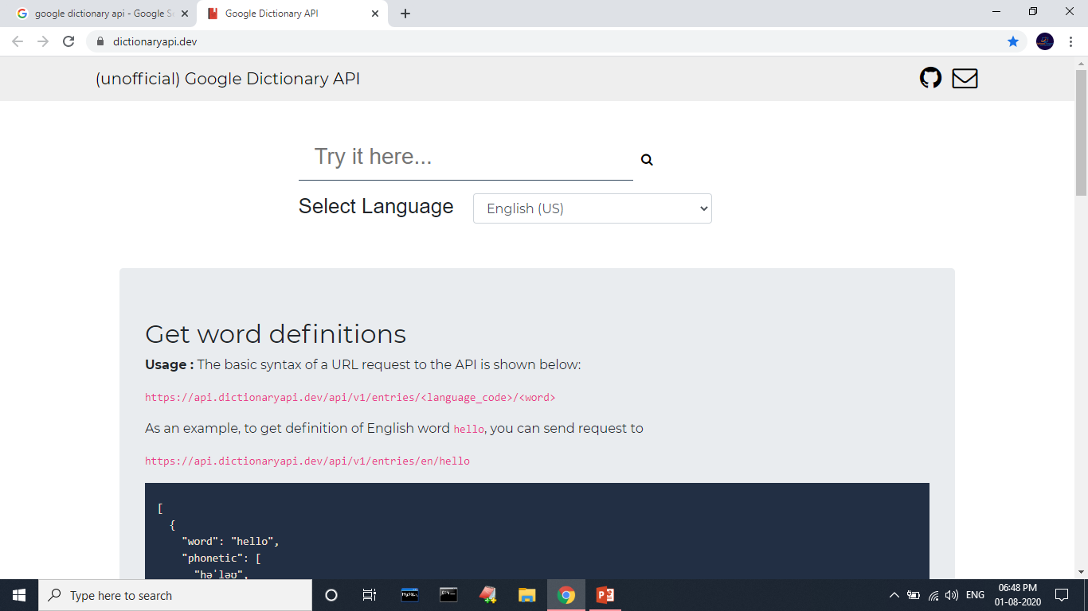
Google dictionary api
API LINK:-
https://dictionaryapi.dev/

Slide 6
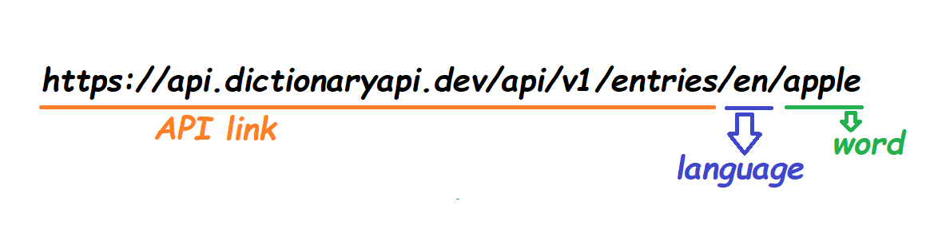
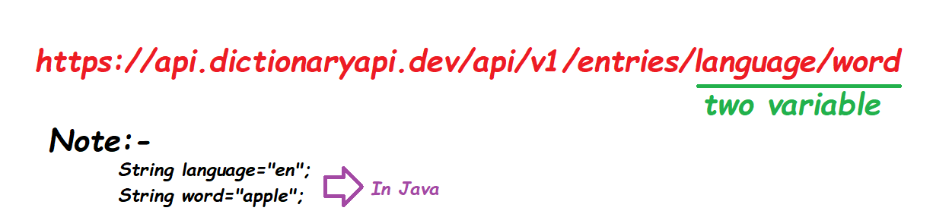
API URL
Default Link
Modified Link

Slide 7
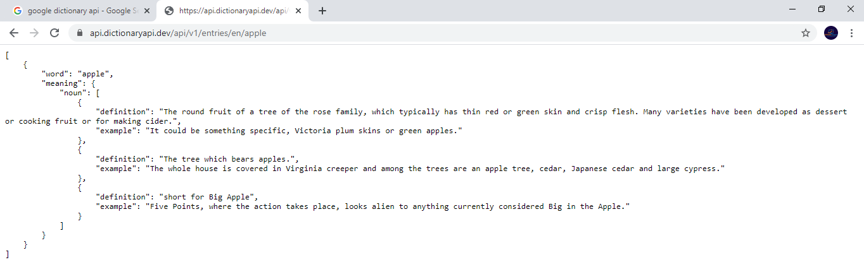
Output of URL in JSON Format

Slide 8
Java internet connection
URL url=new URL("https://api.dictionaryapi.dev/api/v1/entries/<language_code>/<word>");
HttpURLConnection huc=(HttpURLConnection)url.openConnection();
BufferedReader in = new BufferedReader(new InputStreamReader(connection.getInputStream()));
String urlString = "";
String current;
while((current = in.readLine()) != null) {
urlString += current;
}
System.out.println(urlString);

Slide 9
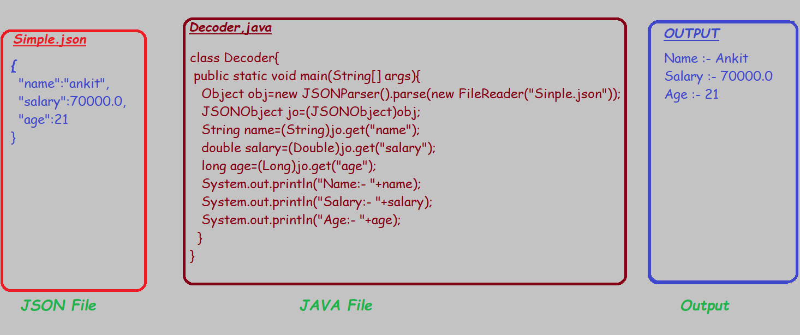
Read JSON File Data with JAVA
Download JAR file json.simple.1.1.1.jar

Slide 10
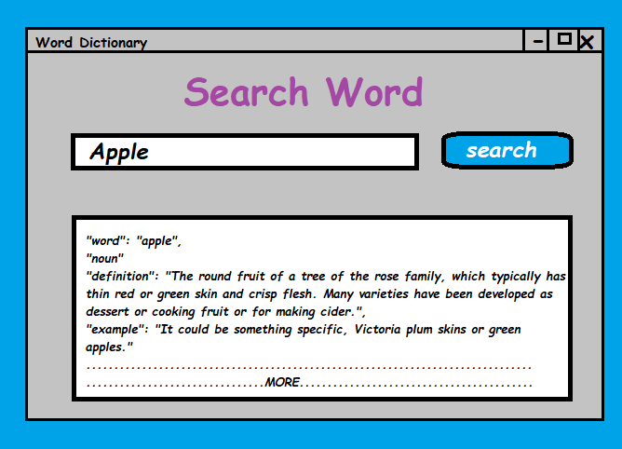
Result Like:-

Slide 11

Great things never come from comfort zones. Dream it. Wish it. Do it.
Don’t stop when you’re tired. Stop when you’re done

Slide 12
END PROJECT
Thanks
Complete at least seven days

